Slide 1
FHIM: A Business Perspective
Last updated: March 8, 2016
This is a working document; it is not approved for official use / public distribution.
Notes:
What’s above is an edited version made to reflect more fully what is being conveyed. While I like it better, given it’s not just about FHIM. It’s most prominent, BUT in going forward FHIM’s success is about how it can better integrate with other assets. This briefing touches on all that should come together. So this may need an ‘adjusted title’ given what I just described
The two alternates used were:
Value Proposition: A Business Perspective
And previous to that:
Federal Health Information Model (FHIM) Plus Model Driven Health Tools (MDHT) Game Changer for Exchange of Health Information
Leverage and once the brief has been sanitized/finalized adjust accordingly.

Slide 2
FHIM: An Information / Data Organizing Resource
What was the impetus for FHIM?
What is FHIM anyway?
I don’t know anyone that uses FHIM?
FHIM, VHIM, CIMI, HL7’s RIM…how does one make sense of it all?
In the midst of so many advancements, are information models still necessary?
Why do we need FHIM if we have FHIR?
If we have an (EHR) vendor that has a built in information model, why do I care about FHIM?
Keeping Pace: Legislation, Standards, Expanding Ecosystem & Stakeholders
Can Implementation variability be minimized?
As Semantic Interoperability gains importance so does the role of Information / Terminology Models
What resources exist to minimize HIT Complexity?
It is the interplay of our assets that makes for success; Where does FHIM & related resources fit?
The prominence and pace of change extends HIT complexity, implementation variability which constrains optimum interoperability. As an applied resource, FHIM & connected resources serve to minimize HIT complexity & risk

Slide 3
Federal Health Information Model (FHIM)
A single authoritative and consistent source for health information which among others has been referenced by the VA and MHS
Development is dynamic, keeping pace with advances in:
Standards & Terminologies
HL7, SNOMED, LOINC, RxNorm, NCPDP, etc.
Implementation Resources
FHIR, C-CDA, etc.
Tooling
Model Driven Health Tools

Slide 4
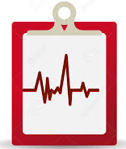
What is in the FHIM
The FHIM contains use case scenarios and data for providers and payers, as well as public health and regulatory agencies to build a better EHR.
Administrative Information
Personal/Medical History
Provider Information
Enrollment
Benefit Eligibility
Benefit Coordination
Clinical Information
Orders
Lab Records/Results
Medications
Procedures
Images
Medication/Allergies/Adverse Events
Outpatient Encounters
Health Concerns

Slide 5
FHIM’s Model Driven Health Tools (MDHT)
Model Driven Health Tools (MDHT) reference and rely on models like the FHIM to create:
Callable Application Programmer’s Interfaces (API)
Wire implements, e.g. XSD Schematrons
Test harnesses
Implementation guides, e.g.
Can normalize FHIR across all the different profiles currently being hand crafted so implementations are as consistent as they are fast
*

Slide 6
FHIM Start Up / Value
FHIM was initiated in 2009 in response to ARRA / Hitech mandate whereas options (HL7 RIM / CIMI) were not able to meet federal partner’s needs
Through the collaboration of federal partners and under the oversight of the FHA, FHIM is governed
An authoritative and consistent source to support the exchange of health information
Logical Information Model of Health Data developed in collaboration with the federal agency experts
Harmonizes content (information, terminologies and value sets) across federal partners and standards organizations so standards-based solutions work as intended
Platform independence facilitates modeling once, applying anywhere

Slide 7
FHIM Value: External Review
The Open Group’s “Enhancing HIE with the FHIM” Report (April 2015) commends the FHIM for:
Cataloging key shared information exchange needs based on actual scenarios provided by 20 federal partners in a structured model populated with consensus-based industry standards
Documenting the model building processes which is key to building understanding, confidence, and support
According to the Open Group Healthcare Forum, “Relating the FHIM to other major efforts to achieve healthcare interoperability can be an important step in helping to enable The Open Group vision of Boundaryless Information Flow.”

Slide 8
FHIM Value: Drivers & Contributors
Federal Partners, including, but not limited to:
VA Health Business Information Model
SSA and CMS identity, person and other initiatives
CDC community/public-health initiative
NCI Cancer Informatics Program
FDA Data Standards Program
Federal Standards Committees
Clinical Information Modelling Initiative (CIMI)
Standards Organizations, including, but not limited to:
HL7, ASTM, NCPDP, RxNorm,
HITSP, DICOM, X12
Standards and Interoperability (S&I) Framework Initiatives

Slide 9
FHIM Value: Alignment
FHIM keeps pace with advances in
Standards & Terminologies
Examples: HL7, SNOMED, LOINC, RxNorm, NCPDP, etc.
Implementation Resources
Examples: FHIR, C-CDA, etc.
ONC sponsored initiatives
Examples: CQF, SDC, DAF
Tooling
IBM RSA, Sparx EA,
MDHT: Recently engaged; partnership extends utility to implementations
NLM Value Set Authority Center (VSAC)

Slide 10

FHIM Information Domains - Modeling Status
(as of Jan 2016)
FHIM Information Domains
Information Domain | Information Modeling Status | Terminology Modeling Status
AdverseEventReporting | Complete | Complete
Allergies | Complete | Complete
Assessment | Complete | Baselined
Audiology And Speech Pathology | Baselined | Baselined
BehavioralHealth | Partially Complete | Baselined
BloodBank | Baselined | Baselined
CarePlan | Complete | Complete
ClinicalDecisionSupport | In Progress | Baselined
ClinicalDocument | Baselined | Baselined
ClinicalObservation | Complete | Complete
Consultation | Baselined | Baselined
Dental | Baselined | Baselined
Dietetics | Baselined | Baselined
Encounter | Complete | Baselined
EnrollEligibilityCOB | Complete | Baselined
HealthConcern | Complete | Complete
HomeBasedPrimaryCare | Baselined | Baselined
Imaging / Radiology | Complete | Complete
FHIM Information Domains
Information Domain | Information Modeling Status | Terminology Modeling Status
Immunizations | Complete | Complete
Lab | Complete | Complete
OncologyRegistry | Baselined | Baselined
Orders | Complete | In Progress
PatientEducation | Baselined | Baselined
Person | Complete | Complete
Medications/Pharmacy | Complete | Complete
Prosthetics | Baselined | Baselined
Provider | Complete | Complete
Public Health Reporting | Partially Complete | Baselined
SecurityAndPrivacy | Complete | Baselined
SocialWork | Baselined | Baselined
SpinalCord | Baselined | Baselined
Surgery | Baselined | Baselined
VitalSigns | Complete | Complete
WomensHealth | Baselined | Baselined
Common | Complete | Baselined
Datatypes | Complete | Complete
In production
2

Slide 11
Accomplishments
A comprehensive model
Healthcare information has been modeled by priority of usage
Team has already modeled over 85% of all information types exchanged
Mapped to all S&I Framework Initiatives
An integration of FHIM and associated terminology models with Model Driven Health Tools (MDHT)
Process guides
Generate candidate implementation standards in CDA & NIEM
Generate comparative reports between two versions of the FHIM providing version control capability
Definition of a UML profile to support enhanced report generation

Slide 12
Uses / Users: (1 of 4) Decompose with Organization/actual user/any reliance
Active Contributor to NLM Value Set Authority Center (VSAC)
VSAC holds MU value sets and FHIM value sets
VHA Business Information Model updates for VistA Modernization (Bob)
VistA/CPRS and/or Vista Evolution (VE)/e Health Management Platform (eHMP) (Bob)
S&I Framework Community Led Initiative on Public Health Reporting (FHIM products delivered) Detail came from Steve
Open Group efforts to achieve their vision of boundary less information flow*
DaVita (the nation’s largest dialysis provider) uses FHIM as part of a systems consolidation/modernization effort. Came from Galen; try to get a name

Slide 13
Uses / Users: (2 of 4) DHA/MHS Business and Enterprise Architectures Offered from Nancy Orvis, Standards Div and Alan "BART" Bartholomew GS-15 Chief Enterprise Architecture Branch DHA, PfM &CR Division
Conceptual data view (DoDAF DIV -1)
Consistent entity names, definitions, relationships
DODAF DIV-2 logical data view
adds consistent attributes, terminology, value sets; where,
interoperability requires venders to have physical schema that conform to DHA’s DIV-2
Mapping of use cases to system objects, components and services
DIV-2 constrained EHR-S FM functions composed into objects and components
DIV-2 constrained Information Model for common services
DIV-2 constrained DAF-FHIR profile for DOD-VA Health Data Services (HDS)
Successful (interoperable) transition of legacy to future-state systems requires:
Legacy physical schemas mapped to DIV-2; and, DIV-2 mapped to future-state systems’
databases, exchanges and viewers
public health surveillance, research
clinical decision support, population health analytics
HIPAA, Meaningful Use stage 2/3, ARRA/HITEC Act and NDAA compliance

Slide 14
Uses / Users: (3 of 3)
HL7 CIMI balloted Common Logical Information Model (CLIM)
HL7 CIMI co-chairs: Stan Huff MD, (Intermountain Healthcare), Linda Bird BIT PhD (ITSDO), Galen Mulrooney (DoD and VA support), Harold Solbrig, (Mayo Clinic)
Jan-Sep 2016 HL7 Clinical Information Model Initiative (CIMI) sponsored an Investigative Study of a CIMI compliant Federal Health Information Model (FHIM) profile and Computer Aided Design (CAD) Tooling; where,
FHIM defines healthcare domains and high-level information-exchange classes (aka entities) in those domains; and where,
FHIM classes are the context for CIMI Clinical Modelling Patterns constrained into Detailed Clinical Models (DCMs).
The FHIM profile and DCMs are collectively referred to and will be balloted as the CIMI curated “Common Logical Information Model (CLIM)”.
An HL7 balloted CLIM (CIMI DCMs and FHIM) are expected to be used by The Healthcare Services Platform Consortium (HSPC, a provider-driven organization of leading healthcare organizations, IT vendors, systems integrators). Government, industry and academia.

Slide 15
Users / Usage (Slide 4 of 4) Nikolay Lipskiy, MD, PhD, MBA Medical Epidemiologist; Informatics Scientist Centers for Disease Control and Prevention (CDC)
FHIM modeling efforts are critical for public health. Specifically, the participation of FHIM Team members in the S&I Public Health Reporting initiative (PHRI) was critical for development of the documents mentioned below.
The S&I PHRI is one of the critical activities in the harmonization of public health vocabulary. Developed by PHRI, the “Data Harmonization Profile” is listed by CDC as the one of the reference standards for public health reporting (see at: http://www.cdc.gov/phin/resources/standards/data_interchange.html). Also, this document is included into the Vocabulary Access and Distribution System (VADS) vocabulary domain for PH Preparedness/Surveillance (see at: https://phinvads.cdc.gov/vads/SearchHome.action). We are looking to further leverage FHIM to support the data requirements of the PH Preparedness/Surveillance project.
CDC is also looking at the FHIM to support a very important national CDC activity for harmonization of vocabulary and improvement of health data architecture. Working with FHIM team to determine timeline/approach
Notes:
Nikolay Lipskiy, MD, PhD, MBA
Medical Epidemiologist; Informatics Scientist
Centers for Disease Control and Prevention (CDC)
Office of Public Health Preparedness and Response (OPHP)
Phone: 404-639-0567

Slide 16
Users/Usage Pending
Nona & Bob – IPO JET connections (2)
Bob: VA reach out of 3 – 4 individuals
Danny Territo / COL John Scott: DoD/VA HDS Bus Line Group use of FHIM

Slide 17
Current State Efforts: An Opportunity to Further Integration via Going Forward Strategies
FHIM & Other Modeling Efforts & Outputs
Standards Organizational Efforts
Tooling Activities / Resources
Initiatives / Working Groups / Implementations

Slide 18
Desired State
Business Driven: Use Case Requirements Received
Requirements derived from existing specifications
FHIM Content Requirements UML Class Model
& Terminologies
CIMI modeled clinical requirements
MDHT / MDMI
UML Profile: CDA
UML Profile: FHIR
UML Profile: NIEM
UML Profile: CIMI
NIEM IG
NIEM IG
NIEM IG
FHIR IG, Java, JSON
NIEM IG
NIEM IG
NIEM IG
CDA IG, Java, XML
NIEM IG, etc.
CIMI ADL
Use output to confirm FHIM & MDHT process
Translators
Notes:
High-level FHIM / MDHT concept.
The FHIM is a conceptual UML model that harmonizes requirements from various federal interoperability use cases.
MDHT is a tool that can use UML profiles to generate design artifacts such as implementation guides, as well as java classes to create or validate instances of specifications.

Slide 19
Interoperability Specifications Development Process (abridged)
Steps below follow the FHIM Information Modeling Process Guide, FHIM Terminology Modeling Process Guide and the Model Driven Architecture Process Guide using Model Driven Health Tool (MDHT) capability:
Receive business use case/requirements from the business user community
Evaluate use case/requirements with the user
Identify the exchange of information and intended target platform
Create UML use case diagrams as needed
Enhance/extend FHIM with missing data elements as needed where gaps exist
Review existing FHIM content and constrain to the information needed based on the use case
Beginning with the full FHIM, identify applicable domains and within each domain constrain further to relevant classes/subclasses, data attributes, value sets and cardinality
Generate the target platform specific model
Generate artifacts for the target specification standard, e.g., generate JAVA APIs and test suites; NIEM IEPD, IG with xml schemas based on the platform specific model
Gain quality review of artifacts by clinical, terminology, and desired platform standards experts
Loop back to top until quality has been confirmed
Pilot test the resulting draft interoperability specification standard
Respond to test results as needed.
Submit to SDO for formal standards approval (all artifacts)
Notes:
What Slide Looked Like Right Before this last edit:
Steps below follow the FHIM Information Modeling Process Guide, FHIM Terminology Modeling Process Guide and the Model Driven Architecture Process Guide using Model Driven Health Tool (MDHT) capability:
-Receive from the business user community the business use case / requirements
What’s received may range from descriptive use cases with or without excel spreadsheets and/or UML diagrams
-In cooperation with the User, begin the evaluation of use case / requirements
Identify the exchange of information and target platform intended
Create UML use diagrams, as needed (based on level of definition made available)
- Based on the decomposed use case, review existing FHIM content and constrain to the information needed
Beginning with the full FHIM, identify the applicable domains; within each domain constrain further to the relevant classes/subclasses, data attributes, value sets and cardinality
- Where gaps exist, enhance / extend FHIM with missing data elements as needed for a platform independent model (PIM)
- Generate the target platform specific model
- Use the platform specific model to generate artifacts for the target specification standard, e.g., generate JAVA APIs and test suites; NIEM IEPD, IG with xml schemas based on what platform specific
- Gain quality review of artifacts by terminology and desired platform standards experts
Loop back to top until quality has been confirmed
- Pilot test the resulting draft interoperability specification standard
Respond to test results as needed.
- Submit to SDO for formal standards approval (all artifacts)
FYI…..details here are from Steve W & are based on old S&I processes; facelift needed; HIM WG also needs a facelift; both may prove relevant ways to get this messaging & expanded engagement opps introduced.
FHIM interoperability specifications are developed to meet the following definition of health interoperability:
Interoperability has been generically defined as “The ability of software and hardware on different machines from different vendors to share data.” In a health environment, a higher degree of interoperability is required and can be measured by the degree to which all health information relevant to an individual is completely, timely, reliably, accurately, securely, and accessibly integrated to support health services provided to the individual. Above all, interoperability means that the intended meaning of the information is interpreted in the same way by the sender and the receiver. Information needs to be understood at the point of care and available to local decision support mechanisms. Achieving interoperability is no easy task due to the complexities of health concepts. Achieving health interoperability requires:
Information that is computable and understandable, i.e., the ability for information shared by systems to be understood at the level of formally defined concepts;
Information that is in a standardized, coded format whenever possible;
Information that can be used by systems addressing payment, research and clinical uses, including computations to support clinical decision making and performance measurement;
Display of information from outside sources with that generated internally; and
Information that can be stored in coded form within a data repository other than the repository that generated it.
As a result, FHIM interoperability specifications are not just the FHIM model, but a complete set of artifacts to fully support interoperability, including:
Harmonized information concepts that are defined to meet the above definition of interoperability
Harmonized terminology and value set information that is defined to fully support semantic interoperability
Implementation guides/interoperability specifications that includes the information concept and terminology/value set information described above as well as APIs for developers to develop instance implementations of the interoperability specification, a test suite for verifying that the implementation fully conforms to the interoperability specification and other electronic information to assist developers in developing their instance implementations.
FHIM can also export the information model and its contents into an XML Model Interchange (XMI) format that can be used by federal partners for other purposes, such as designing physical databases in their organizations.

Slide 20
Going Forward Strategies: Partnership
Recommendation: The FHIM paired with MDHT is a Game Changer for HIE Partners and SDOs
Benefit: FHIM+MDHT automates the creation of implementation components supporting logical groupings of HIE requirements
HIE requirements are grouped to support standard or custom use cases, and clinical or administrative document exchange
The FHIM provides the necessary authoritative source of HIE semantics
Entities and Relationships
Data Elements and Data types
Value Sets and Terminology Bindings
Cardinalities, Business Rules, etc.
The desired HIE standards and technologies must then be specified (e.g. Java, FHIR, MLLP)
Generated HIE Components
The first generated component is an implementation guide
The other generated components are the HIE software

Slide 21
Going Forward Strategies: Benefit to Implementations
As a Game Changer FHIM+MDHT Provides Significant Benefits
Generated implementation guides and components provide stakeholders with clear, accurate, consistent, and stable blueprints for supporting HIE industry standards
Vendors and partners can leverage FHIM+MDHT to support their HIE standards of choice (C-CDA, FHIR, etc.)
Inconsistencies across standards organizations are resolved and flagged
New sets of guidelines and implementation components are quickly regenerated when standards change
Tedious and error-prone manual steps are eliminated
[Is there a testing/fool-proofing benefit we should point out?]

Slide 22
Going Forward Strategies: Integrate/ Engage
Engage efforts where major players are coming together with an openness to integrate resources
CIMI has joined HL7
Actions to integrate CIMI and FHIM while leveraging tooling to support multiple implementations are in play
Extend the benefit of assets (FHIM, CIMI, MDHT/MDMI, etc) through engagement with active working groups
The necessity for the DoD/VA HDS Workgroups for example to know the data that exists and determine the data needed is where these assets can make a difference
Applied as a norm across all initiatives forms a foundation for our community but also those we interoperate minimizing implementation variability

Slide 23
Back Up / Team Actions

Slide 24
FHIM Value Proposition Team: Clarifying Actions
 | Action | Status / POC
22 Feb FHA Managing Brd, 23 Feb Team Meeting | Focus on product / detail that emphasizes FHIM Evaluation / specific users (down to organization / persons. | Team
4 Mar Team Meeting | Focus on enhancements to slides 10 and 11 where current Users / Uses resides. Build up the actual offices and users engaged (to personalize known and less known use. Make more obvious the contnection to the modernization efforts where that is. | DoD and VA POCs
4 Mar Team Meeting | With insert of slide 3 of 3 of Uses, edit to enhance understanding related to 5 moonth investigative effort | S Hufnagel
Notes:
I think this effort could benefit from a "communication plan" approach, defining
1. specific communication goals
2. identification of optimal messages, audiences, and channels to achieve these goals (and assumptions: live preso-only vs. standalone file, with/without notes, use of other media e.g. Twitter, etc.)
3. resources for creating & reviewing these assets, who would then define the content, format, etc.
4. dates to ensure they get completed
And resulting in
5. Targeted communication tools that perform specific tasks clearly and verifiably.
Goals might include, e.g.,
"explain to federal agency decision makers why an agency would want to adopt the FHIM as a base for its information architecture"
"explain to ONC decision makers how ONC can use the FHIM to generate harmonized US realm standards"
"explain to agency architects how they would use the FHIM to guide internal development aligned with federal standards."
"explain to SDO programs how FHIM fits with and supports their programs" (probably tailored to program)
I am afraid that general decks without very specific purposes provide opportunities for prospective and abstract "thinking out loud" that, while they can be fruitful when used internally, externally may be taken as evidence that there is no "there" there.
From Nona: In broader terms, the larger intent is to:
Enhancing (through communications & messaging) Awareness of the Resource and Association with other Assets
Enhance Appreciation of the Benefits via Active Engagements
Ultimately, institute an ongoing and lifecycle application
Enhance the Usability by applying feedback
Measure impact, e.g., streamlined implementation, reduction of implementation variability / less FHIR Profile Variability Proliferation

Slide 25
FHIM Value Proposition Team: Actions
Source | Action | Status / POC
Jan 26, 7:45pm email from Nona & Feb 2, 6:15pm email from Nona | Produce a reconciled version of the Abridged Description of Steps detailing how FHIM / MDHT / MDMI are applied. Apply associated graphics. - Replaces slide 18 of our Master Deck. Should reference / integrate 8 steps Alberto had provided; I offered clarifying questions & talks with Sr Leaders seek ‘what occurs; when; by what asset and then what’s the output’ - See slides 17 & 19: review proposed graphic of ‘currents vs desired state’ | Steve W / Alberto / Galen
Feb 2, 6:15pm email from Nona | Action: Review and provide feedback via inserted comments to FHIM: A Business Perspective / Going Forward Strategies brief (2 week review given / passed; inputs outstanding). Target areas: - Streamline initial slides (3-5) that aim to set the stage / compel folks to want to address the current state of HIT complexity; to learn how FHIM, etc is there to make a difference - Slide 5: Standards Convergence, change to Convergence of Standards. Yes? No? - Slide 6: Streamlined the Agenda per feedback from Comm Team - Offer FHIM Examples to vividly show what FHIM is offering -- MDA Process Guide (provided by Steve W) provided to assist - Review edits to Going Forward Strategy slide 22 - Consider a slide within back up that informs reader of other supporting topics that can be provided via master deck - Ultimately, trim down/combine so the deck lands at 15 or less - Apply FHA Template (Nona / Comm Team) Via MDMI advocate a FHIM based referenced index Introduce better understanding of role MDHtT / MDMI has ….slides at present don’t‘ represent this | Team
Feb 2, 6:15pm email from Nona | Action 2: Throughout message, certain statements were made to ‘advocate a position’. Review / forward any edits to those assertions - Apply to FHIM Principles type slide in Master Deck | Team
Feb 16, 11:29am from Jay | Address Jay’s perspective related to Comm Plan approach. Per Nona’s recommendation, apply original prompts via invite series (See notes page) | Team
All Meetings | Identify / Recommend engagements where FHIM / FHIM along with MDHT – MDMI can be applied / demonstrated. What is occurring now? | Team
MDHT Team | Take care in relaying connection of FHIM to MDHT/MDMI Take care in not over applying MDHT / MDMI as they are not the same thing or not always ‘both’ applied | Team
Feb 22 Managing Board | This was confirmed as an interest but the first ask is to deliver the What is FHIM / Use /Usage elements. We gained clearance to offer the desired state (ties to MDHT / MDMI) but first hit the Current State Value | Team
Notes:
I think this effort could benefit from a "communication plan" approach, defining
1. specific communication goals
2. identification of optimal messages, audiences, and channels to achieve these goals (and assumptions: live preso-only vs. standalone file, with/without notes, use of other media e.g. Twitter, etc.)
3. resources for creating & reviewing these assets, who would then define the content, format, etc.
4. dates to ensure they get completed
And resulting in
5. Targeted communication tools that perform specific tasks clearly and verifiably.
Goals might include, e.g.,
"explain to federal agency decision makers why an agency would want to adopt the FHIM as a base for its information architecture"
"explain to ONC decision makers how ONC can use the FHIM to generate harmonized US realm standards"
"explain to agency architects how they would use the FHIM to guide internal development aligned with federal standards."
"explain to SDO programs how FHIM fits with and supports their programs" (probably tailored to program)
I am afraid that general decks without very specific purposes provide opportunities for prospective and abstract "thinking out loud" that, while they can be fruitful when used internally, externally may be taken as evidence that there is no "there" there.
From Nona: In broader terms, the larger intent is to:
Enhancing (through communications & messaging) Awareness of the Resource and Association with other Assets
Enhance Appreciation of the Benefits via Active Engagements
Ultimately, institute an ongoing and lifecycle application
Enhance the Usability by applying feedback
Measure impact, e.g., streamlined implementation, reduction of implementation variability / less FHIR Profile Variability Proliferation

Slide 26
Appendix (list of acronyms, links & POC, etc.)

Slide 27
FHIM Resources (Links, 1 of 2)
FHIM Logical Information Model: where,
FHIM Terminology Value Sets are on CDC PHIN/VADS
FHIM Terminology Value Sets are on NLM VSAC
UMLS license required to see content
FHIM Domains
Project Documents
FHIM Model-Driven Implementation Process Guide
Terminology Modeling Process Guide
Information Modeling Process Guide
Information Modeling Style Guide
MDHT

Slide 28
Additional FHIM Resources (Links, 2 of 2)
FHIM Fact Sheet & Related Links
Pressure Ulcer Sample Model
Model Downloads
FHIM Unfragmented Model as ZIP file
FHIM XMI Version of the Model as ZIP file
FHIM Terminology Model as ZIP file
Slide Presentation: FHIM Model Content Overview
Conferences, Presentations and Data Sheets
Federal Health Architecture Data Sheet
Government Health IT Conference & Exhibition
HHS ONC Intro to NIEM and the S & I Framework
Mitre Publications
Public Health Reporting, Clinical Element Data Dictionary (CEDD) Feb. 2012
Related Links
FHIMS Registration Information
Information Model Fundamentals
S & I Framework: Clinical Information Models for LRI
HL7 Virtual Medical Record (vMR)

Slide 29
Acronyms
CDA | Clinical Document Architecture |  | IHE | Integrating the Healthcare Enterprise
CCDA | Consolidated CDA |  | IM | Information Management
CMS | Centers for Medicare & Medicaid Services |  | ISA | Interoperability Standards Advisory
DAF | Data Access Framework |  | IT | Information Technology
DBA | Database Analyst |  | JIP | (DOD-VA) Joint Interoperability Plan
EHR-S FM | EHR System Functional Model |  | MDHT | Model Driven Health Tool
FHIM | Federal Health Information Model |  | NIEM | National Information Exchange Model
FHIR | Fast Healthcare Interoperability Resource |  | NIST | National Institute of Standards and Technology
GFI | Government Furnished Information |  | NLM | National Library of Medicine
HIE | Health Information Exchange |  | ONC | Office of the National Coordinator
HIT | Healthcare Information Technology |  | S&I | Standards and Interoperability
HHS | Health and Human Services Agency |  | SDO | Standards Development Organization
IBRM | Integrated Business Reference Model |  | SME | Subject Matter Expert
ICIB | Interagency Clinical Informatics Board |  | V2 | HL7 Version 2 Messaging

Slide 30
Proposed Milestones
FY2016 | FY2017 | FY2018+
General Orders TM (60) | Clinical Documents IM-TM (90) | Surgery IM-TM (180)
Clinical Decision Support IM (180) | Social Work IM-TM (90) | Other FHIM & Terminology Modeling (TBD)
Clinical Decision Support TM (90) | Social Work IM-TM (90)
Consultations IM-TM (180) | Surgery IM-TM (180)
FHIM-MDHT (360) | FHIM-MDHT (360) | FHIM-MDHT (TBD)
FHIM-S&I Integration (360) | FHIM-S&I Integration (360) | FHIM-S&I Integration (TBD)
FHIM-CIMI Integration (60) | FHIM-CIMI Integration (TBD)

Slide 31
FHIM Value: Advocates
Promoters
Catherine Hoang, VA Proponent
Steve Taaffe, VA Proponent
Nancy Orvis, DHA Proponent
Nona Hall, IPO-Proponent
The FHIM is supported by
Galen Mulrooney, FHIM Data-Modeling Lead
Jay Lyle, FHIM Terminology-Modeling Lead
Bobbie Peterson, FHIM Program Manager
Steve Wagner, FHIM Project Manager
Steve Hufnagel, FHIM-HL7 Facilitator
Sean Muir, FHIM MDHT-Implementer
Dave Carlson, MDHT Project Lead
Rob McClure, FHIM Clinical-SME

Slide 32
Agency participants on FHIM calls
Requirements derived from existing specifications
FHIM Content Requirements UML Class Model
& Terminologies
Model Driven Health Tools (MDHT)
UML Profile: CDA
UML Profile: FHIR
UML Profile: NIEM
NIEM IG
NIEM IG
NIEM IG
NIEM IG
FHIR IG, Java, JSON
CDA IG, Java, XML
NIEM IG
NIEM IG
NIEM IG, etc.
Notes:
High-level FHIM / MDHT concept.
The FHIM is a conceptual UML model that harmonizes requirements from various federal interoperability use cases.
MDHT is a tool that can use UML profiles to generate design artifacts such as implementation guides, as well as java classes to create or validate instances of specifications.

Slide 33
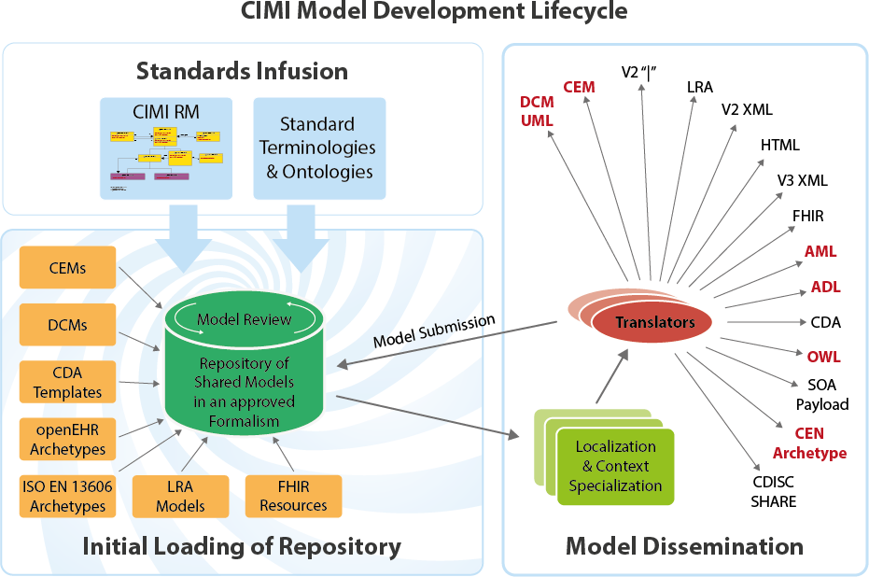
Notes:
CIMI, too, has a vision of collecting clinical requirements (“repository” in diagram) in a format that allows the automated generation of specific wire formats. CIMI focuses on more granular models (sometimes called “detailed clinical models”), while the FHIM provides a macro view, but the technical vision is very similar.

Slide 34
Agency participants on FHIM calls
Requirements derived from existing specifications
FHIM Content Requirements UML Class Model
& Terminologies
CIMI modeled clinical requirements
Model Driven Health Tools (MDHT)
UML Profile: CDA
UML Profile: FHIR
UML Profile: NIEM
NIEM IG
NIEM IG
NIEM IG
NIEM IG
FHIR IG, Java, JSON
CDA IG, Java, XML
NIEM IG
NIEM IG
NIEM IG, etc.
Notes:
High-level FHIM / MDHT concept.
The FHIM is a conceptual UML model that harmonizes requirements from various federal interoperability use cases.
MDHT is a tool that can use UML profiles to generate design artifacts such as implementation guides, as well as java classes to create or validate instances of specifications.

Slide 35
Agency participants on FHIM calls
Requirements derived from existing specifications
FHIM Content Requirements UML Class Model
& Terminologies
Model Driven Health Tools (MDHT)
UML Profile: CDA
UML Profile: FHIR
UML Profile: NIEM
UML Profile: CIMI
NIEM IG
NIEM IG
NIEM IG
NIEM IG
FHIR IG, Java, JSON
NIEM IG
CDA IG, Java, XML
NIEM IG
NIEM IG, etc.
CIMI ADL
Translators
Notes:
High-level FHIM / MDHT concept.
The FHIM is a conceptual UML model that harmonizes requirements from various federal interoperability use cases.
MDHT is a tool that can use UML profiles to generate design artifacts such as implementation guides, as well as java classes to create or validate instances of specifications.

Slide 36
Agency participants on FHIM calls
Requirements derived from existing specifications
FHIM Content Requirements UML Class Model
& Terminologies
CIMI modeled clinical requirements
Model Driven Health Tools (MDHT)
UML Profile: CDA
UML Profile: FHIR
UML Profile: NIEM
UML Profile: CIMI
NIEM IG
NIEM IG
NIEM IG
FHIR IG, Java, JSON
NIEM IG
NIEM IG
NIEM IG
CDA IG, Java, XML
NIEM IG, etc.
CIMI ADL
Use output to confirm FHIM & MDHT process
Translators
Notes:
High-level FHIM / MDHT concept.
The FHIM is a conceptual UML model that harmonizes requirements from various federal interoperability use cases.
MDHT is a tool that can use UML profiles to generate design artifacts such as implementation guides, as well as java classes to create or validate instances of specifications.

Slide 37
Executive Summary (Objective, Approach)
The objective, of the 9 month HL7 investigative study, is to
demonstrate that we can automatically transform an instance of one data standard into an instance of another data standard, based on a single shared & documented understanding of information & functional requirements.
This capability will support actual semantic interoperability among stakeholders currently prevented from such interoperability by divergent standards,
and it will do so in a way that enforces consistent semantics across any community that uses it.
Demonstrate Open Group HIE™ instantiated with Health IT models and standards, including
Common Information Modelling Initiative (CIMI) archetype models,
Federal Health Information Model (FHIM) and Detailed Clinical Models (DCMs) UML Models
Demonstrate archetype versus UML Modeling styles.
Demonstrate UML archetype Modeling Language profile models and CIMI reference model.
Document processes, products and tools in “Practitioner's Guide for HIE Interoperability .”
Develop a comprehensive HL7 FY2017 Project Scope Statement / Program Plan
The approach will instantiate The Open Group HIE™ Reference Architecture and Value Chain-based operating model with Health IT models, Frameworks and artifacts, following a cyclic Agile build, test, evaluate, document and re-plan methodology.
3/25/2016
This is a working document; it is not approved for official use / public distribution.

Slide 38
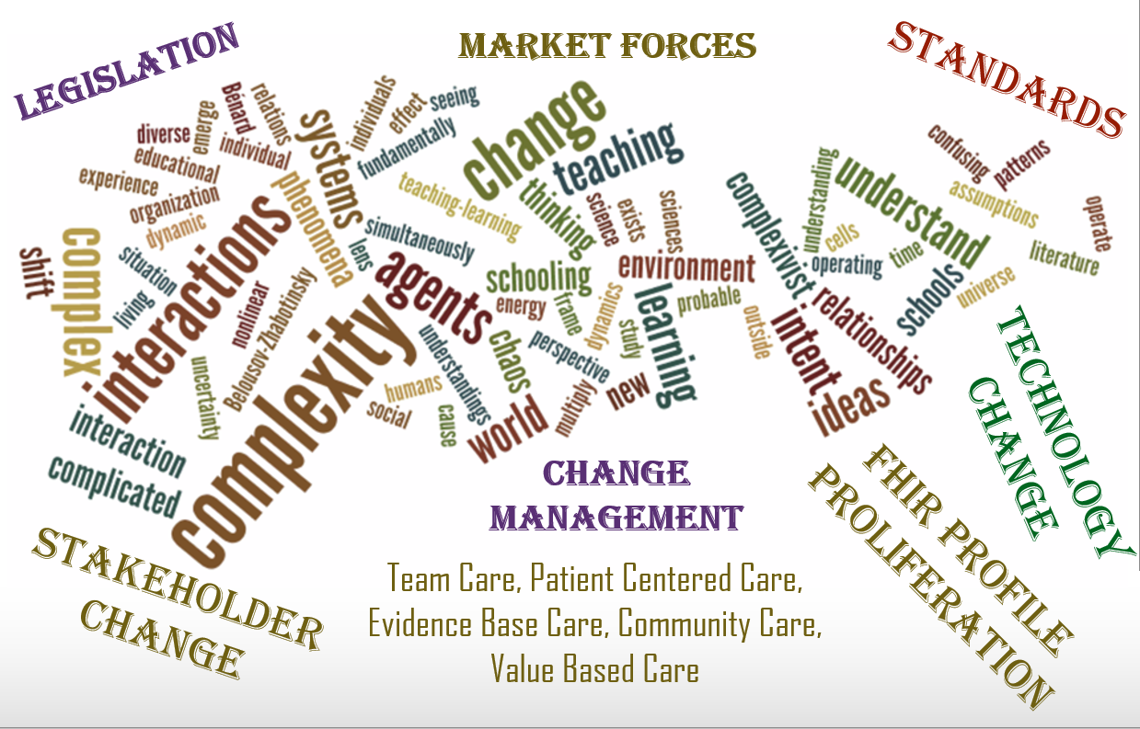
FHIM: An Information / Data Organizing Resource
The prominence and pace of change extends HIT complexity, implementation variability and constrains optimum interoperability. As an applied information resource, FHIM & connected resources serve to minimize HIT complexity & risk
Notes:
From Contacts with colleagues:
CAPT Trinh: Started with a problem about how in the current state standards are not easy to implement and in fact are implemented in different ways by different vendors. In reply Galen stated that is actually the Strength of FHIM. It exists in essence as a organizing paradigm so that if DoD and VA leverage FHIM as their logical information model those implementation challenges are past history.
Recommended a Slide that in an Erratic Fashion Initiated the Brief with a Slide that portrayed a lot of short statements; each a different problem statement associated with FHIM and in total a prompt to compel people to want to address the challenge….to learn of FHIM and related assets. The sampling of problem statements can include but is not limited to:
I don’t know anyone that uses FHIM?
What is FHIM anyway?
In the midst of so many advancements are information models still necessary?
If we have a vendor that has a built in information model, why do I care about FHIM?
If we have FHIR, why do we still need FHIM?
FHIM, VHIM, CIMI, HL7’s RIM…how does one make sense of it all?
The ecosystem is expanding and with that so is the information data model
The Interoperability Roadmap expects a learning health system
What in slide 2 and 3, was (as I now understand it) from an outside slide and why it has so much other language. This ‘if kept’ to help set the stage, will likely need to be redone to reflect the salient statements . Consider both slides to get what is best suited to make the point

Slide 39
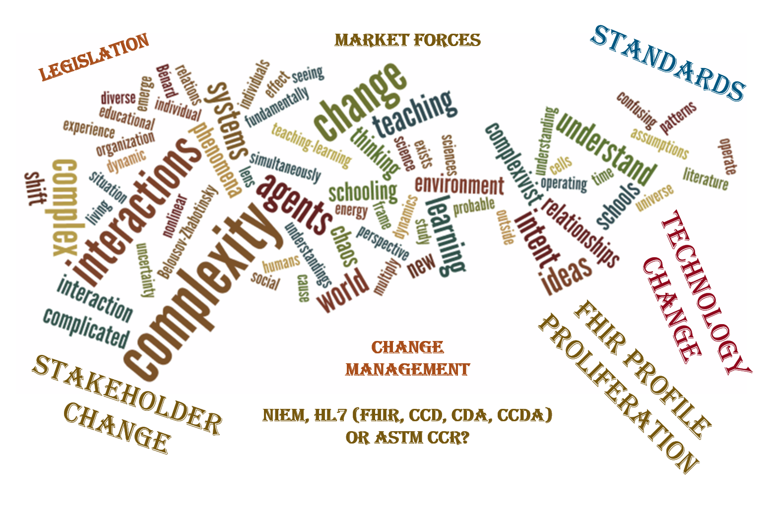
Harmonized authoritative information source designed & built to minimize HIT complexity risks
Notes:
From Contacts with colleagues:
CAPT Trinh: Started with a problem about how in the current state standards are not easy to implement and in fact are implemented in different ways by different vendors. In reply Galen stated that is actually the Strength of FHIM. It exists in essence as a organizing paradigm so that if DoD and VA leverage FHIM as their logical information model those implementation challenges are past history.
Recommended a Slide that in an Erratic Fashion Initiated the Brief with a Slide that portrayed a lot of short statements; each a different problem statement associated with FHIM and in total a prompt to compel people to want to address the challenge….to learn of FHIM and related assets. The sampling of problem statements can include but is not limited to:
I don’t know anyone that uses FHIM?
What is FHIM anyway?
In the midst of so many advancements are information models still necessary?
If we have a vendor that has a built in information model, why do I care about FHIM?
If we have FHIR, why do we still need FHIM?
FHIM, VHIM, CIMI, HL7’s RIM…how does one make sense of it all?
The ecosystem is expanding and with that so is the information data model
The Interoperability Roadmap expects a learning health system
What in slide 2 and 3, was (as I now understand it) from an outside slide and why it has so much other language. This ‘if kept’ to help set the stage, will likely need to be redone to reflect the salient statements . Consider both slides to get what is best suited to make the point

Slide 40
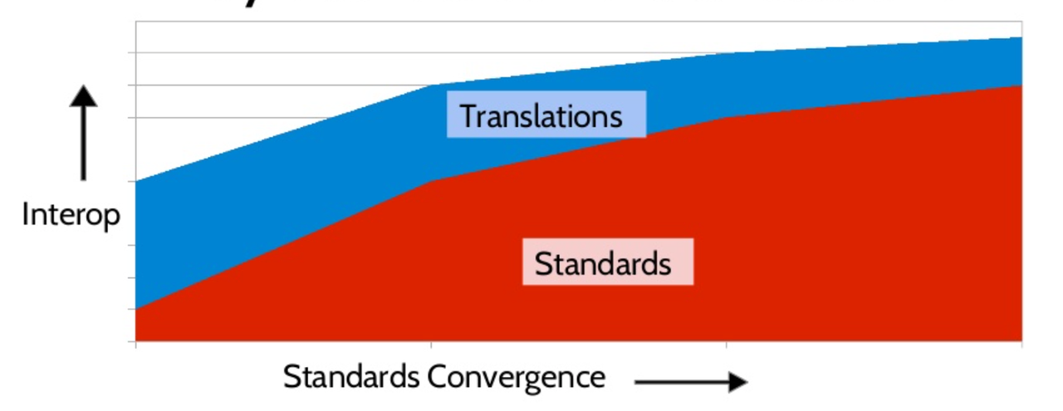
Standards & Translations
Charles I don’t know how to do comments. This is another ‘stage setting slide. Most liked the slide but felt that Standards Convergence needs to read “Convergence of Standards” Via the notes pages is where we can ‘tell the story’ and add in that there’s also a proliferation of standards / standards organizations to also cause us to have resources to always engage
Notes:
This slide was borrowed from the MDHT/MDMI brief provided during the FHA Managing Board of 6 Jan and would need to be redone
Talking Notes:
Today’s past, present and future reality is that there are standards and in some views too many. Over the years these have become more and more precise yet there is now and always will be the fact that certain optionality / ambiguity will be there. That in turn means the effort to address that ambiguity and stay aligned to the intent of the standard has to occur. That also means for as many times as that occurs, there is variation and that deters optimum interoperability.
As standards improve of course that becomes less and less but it will always be there to some degree.
With that and to minimize what becomes variability in implementation, assets such as FHIM (a logical information model) assists in providing a foundational translation so that once developed and reused the variability and one offs are minimized. Add into the picture tools that have also mapped to the standards but focus on extending the information model utility by producing outputs meaningful to implementers such as Implementation Guides. Together these assets serve to standardize and minimize one off mapping efforts that otherwise occur over and over. Compound this picture as what occurs within and organization and across organizations – domestically and internationally.

